Slide 1
Verb tenses
Review

Slide 2
The importance of time
Verb tense expresses the time of an event or action.
Time and how it is expressed in writing is very important to English readers.
The English language has twelve different tenses.
In this lesson, we will review the meaning of each verb tense.

Slide 3
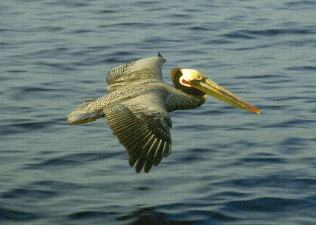


What are the verb tenses?
Verbs do a lot of work in sentences.
They show actions and states of being.
They even take different forms to show time.
flies
flew
will fly

Slide 4
Simple present tense
Express a habit or often repeated action.
Adverbs of frequency such as, often, seldom, sometimes, never, etc. are used with this tense.
Examples:
She goes to work everyday.
They always eat lunch together.
This tense also express general truths or facts that are timeless.
Examples:
Snow falls in the December in New York.
Water boils at 100 degrees Celsius.

Slide 5
present progressive tense
This tense is used to describe an action that is occurring right now (at this moment, today, this year, etc.).
The action has begun and is still in progress.
Examples:
She is typing a paper for her class.
He can’t talk. He is fixing the sink right now.
The present progressive can also be used to describe an action that is occurring in the present, but is temporary.
Examples:
John is living in Chicago, but he might move soon.

Slide 6
Simple past tense
We use the simple past to indicate exactly when an action or event took place in the past.
Examples:
I visited my sister yesterday.
We went out to dinner last night.
The simple past is used to describe actions and/or events that are now completed and no longer true in the present.
Examples:
I attended MJC in 1998. *** I no longer attend MJC.
I saw a movie every weekend when I was a teenager. *** I don’t see movies very much anymore.

Slide 7
past progressive tense
The past progressive is used to talk about an activity that was in progress at a specific point of time in the past.
The emphasis is on the duration of the activity in the past.
Examples:
I was studying for an exam while my mother was cooking.
We were walking in the park around 7 p.m. last night.
The past progressive is often used with the simple past to show that one action was in progress when another action occurred.
Examples:
I was taking a bath when the doorbell rang.
They were eating when the neighbors stopped by for a visit.

Slide 8
Present perfect tense
The present perfect is used to talk about an event that began in the past and continues up to the present.
Examples:
He has lived in Chicago for two years.
***He began living in Chicago two years ago and he still lives there.
The present perfect is also used to talk about an event that was completed in the past, but the specific time of the event is not important.
Examples:
I have seen that movie before.
He has already visited Vietnam.
***Specific dates and times are not mentioned.

Slide 9
Present perfect progressive
This tense is used to describe the duration of an action that began in the past and continues into the present.
Examples:
He has been studying grammar for an hour.
She has been cooking all day.
***He is still studying and she is still cooking.
This tense is also used to describe events that have been in progress recently and are rather temporary.
Examples:
She has been living in London for the last two months, but she plans to move soon.

Slide 10

Past perfect tense
The past perfect tense describes completed events that took place in the past before another past event.
Examples:
The Titanic had received many warnings before it hit the iceberg.
I had already eaten when my friend stopped by to visit.

Slide 11

Past perfect progressive
This tense is used to emphasize the duration of an action that was completed before another action or event in the past.
Examples:
She had been driving around the city for three hours before she finally found the right office.

Slide 12
Future tense
.Will and be + going + to are often used to describe future actions.
Examples:
Tom will graduate in June.
Maria is going to go to Hawaii next week.
The simple present and present progressive are also used to express future time. These are often used in connection with schedules.
Examples:
She is meeting a new client at eleven o’clock.
The train leaves at 6:00 a.m. tomorrow.

Slide 13
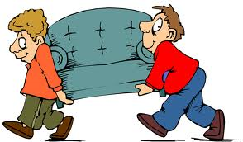
Future Progressive tense
This tense is used to describe an event or action that will occur over a period of time at a specific point in the future.
Examples:
I will be teaching at 10 a.m. tomorrow.
They will be moving their furniture out of the house by the time you arrive tomorrow.

Slide 14

Future Perfect tense
This tense is used to describe an event or action that will be completed before another event or time in the future.
Examples:
We will have finished the exam by the time class ends tomorrow.

Slide 15

Future Perfect progressive
This tense describes an action that has been in progress for a duration of time before another event or time in the future.
Examples:
By the time he finishes law school, we will have been living in Miami for eight years.

Slide 16

Summary – the Future
This is when an event has not yet happened.
I will walk across to buy some sweets from the shop.
I will shout to my brother in the playground.
I will run down the lane with the dog.

Slide 17
Summary – the present
This is when an event is actually happening.
I am walking across to buy some sweets from the shop.
I am shouting to my brother in the playground.
I am running down the lane with the dog.

Slide 18
Summary – the past
This is when an event has already happened.
I walked across to buy some sweets from the shop.
I shouted to my brother in the playground.
I ran down the lane with the dog.

